Slide 1

Forging the trail from solo admin to center of excellence
Jodi Wagner
Solution Architect / Delivery Manager
Cloud Sherpas / Accenture
Notes:
#FDAE17 Gold
#6BB4E5 Light Blue

Slide 2






Thank you to our platinum sponsors!

Slide 3
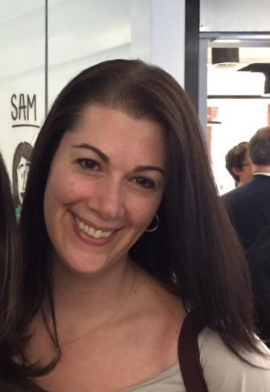
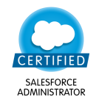
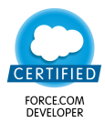
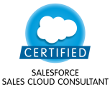
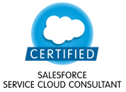

Jodi Wagner
Solution Architect / Delivery Manager
Accenture, Cloud First
Blog: www.forceofanarchy.com
Twitter: @jmwagner

Slide 4
Agenda
Introduction
What is a Solo Admin?
The IT v Business Debate
Proposed Expansion
What is a Center of Excellence?
Why Create a Center of Excellence?
Value Drivers
Call to Action
CoE Structure
Resourcing for the Future
Summary

Slide 5
What is a Solo Admin?

Slide 6

What is a Solo Admin?
Training
Managing Production Support
Salesforce SME
New User Admin
Manage New Initiatives
Business Analysis
Help Desk
Pro Tip: Make sure you’re tracking all requests and time spent on different efforts!

Slide 7

The IT vs Business Debate
What area should “own” Salesforce and its support?

Slide 8

Proposed Expansion – The Tipping Point

Slide 9

Proposed Expansion
+750 Users
+5 Business Units
Territory Mgmt
Sales Planning
+0 Support Staff

Slide 10
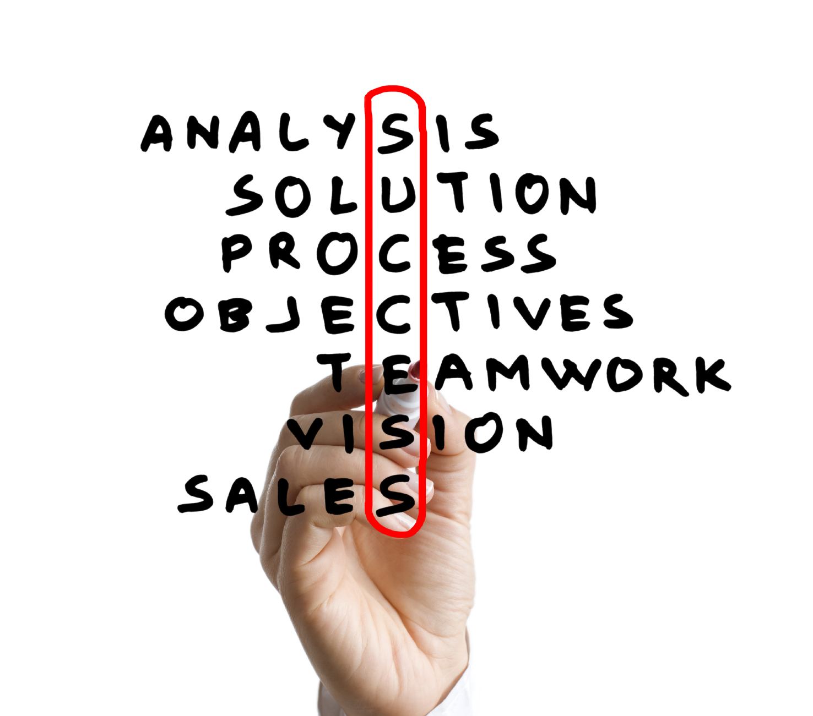


What is a Center of Excellence?
A Center of Excellence Leverages People, Processes, Knowledge, and Technology to drive business value, encourage collaboration, socialize best practices and promote standards across the business
Where a “team” of People come together across disciplines and businesses to collaborate and achieve common goals
Where Processes are defined for best practices in support of CRM strategy, COE objectives and program success.
Where Knowledge experts are utilized to educate and assist the business in meeting their objectives.
Where Technology can be leveraged to drive operational efficiencies and achieve strategic vision.

Slide 11
Why Create a center of Excellence?
  Salesforce is Unique
  Competing Stakeholders: Sales, Marketing, Service across one or more businesses or regions
  Delivering on the Salesforce Promise
  Time to market and easy to change – But discipline and process is essential
  Rapid Pace of Change
  Salesforce thrice annually scheduled releases coupled with ever changing needs of the business
  License Model and Data Management Challenges
  Adoption is critical to justify investment – Users have a wide span and can compromise data
  Single or Multi Org Strategy Decisions
  Organic growth within an enterprise at business unit level or through acquisition

Slide 12
Value Add or Overhead
Business Analysis
Help Desk
Training
Salesforce SME
Manage New Initiatives
Production Support
New User Admin
Value Add
Overhead

Slide 13
Call to Action
The only way to continue to provide Value Added Services was to increase the size of the team and create a hybrid support / delivery model. This model had to be able to support the following core components:
Governance
Business Management
Change Management
Release Management
Support Management

Slide 14
CoE Structure
Governance
  Governance is the processes that ensure the effective and efficient use of technology in enabling an organization to achieve its goals.
Business Management
  Empower the business: know what to deliver, why it is important and the value to the business
Change Management
  Process to manage enhancements, timely delivery to market, prioritization and utilization of resources
Release Management
  Ensure highest quality with structured processes and methodology
Support Management
  Subject Matter Expertize, responsiveness and education
Governance
Business Management
Support Management
Release Management
Change Management

Slide 15
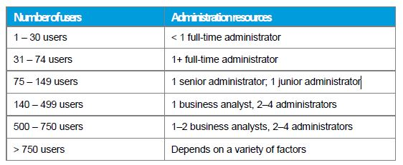
Resourcing for the Future
Onsite team to support business processes and reporting
Extended team in IT to provide development support
Premier Support for after hours support
Consultants for project / initiative resourcing
Managed Service contracts during transitions

Slide 16
Summary
To build your business case to create a Center of Excellence, utilize
these core components:
Track and utilize metrics around time spent on various functions such as new user set up, training, production support, etc. Ensure these are quantifiable
Use resource guidelines from Salesforce around the amount of admins per user as a starting point
Determine your value drivers and which activities are contributing to the success of Salesforce and which are overhead
Organize the Center of Excellence structure that is necessary for your business
Tell your story – use quantitative and qualitative data to support your story and path forward
Measure! Measure! Measure! Do this through reporting and dashboards

Slide 17
Thank you!
Notes:
Please leave this slide in place.

Slide 18







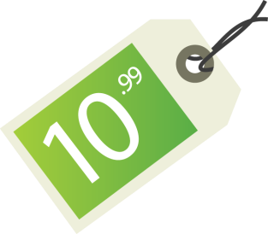
Benefit Model
Operating efficiency
Cost savings
Productivity
“Why Do Anything?”
“Why Now?”
“Why Salesforce?”
Profitability
Value
Cost & features
Revenue uplift
IT cost avoidance

