Slide 1
Blazing the Trail from Solo Admin to
Centre of Excellence
Jodi Wagner
Salesforce MVP & Manager at Accenture
jodi.wagner@accenture.com
Blog: www.forceofanarchy.com
Twitter: @jmwagner

Slide 2






Blazing the Trail from Solo
Admin to Centre of Excellence
Jodi Wagner
Salesforce MVP & Manager at Accenture
jodi.wagner@accenture.com
Blog: www.forceofanarchy.com
Twitter: @jmwagner

Slide 3
Agenda
Introduction – Key Takeaways
What is a Solo Admin?
Quantifying Your Work
Qualifying Your Work
Creating a Plan
Execution: Resourcing for the Future
Governance / CoE Structure

Slide 4
Key Takeaways
How are you going to get there?
Qualify Your Work
Create a Plan
Quantify Your Work
Execute

Slide 5

What is a Solo Admin?
Training
Is it contagious?
Managing Production Support
Salesforce SME
New User Admin
Manage New Initiatives
Help Desk
Business Analysis

Slide 6
So What Do You Do All Day?
Quantifying Your Work
Support Intake
Capture In Salesforce
Measure!!

Slide 7
No, Really.. What Do You Do All Day?
Qualifying Your Time
Business Analysis
Help Desk
Training
Salesforce SME
Manage New Initiatives
Production Support
New User Admin
Value Add
Overhead

Slide 8
Creating a Plan
The Who, Why, What and How
What does your Salesforce landscape look like?
Who will be impacted by any upcoming enhancements, including Winter, Spring and Summer releases?
Why are these enhancements being implemented, changes rolled out or new users being added?
How will changes be implemented?
Is there a roadmap in place for additional efforts with a timeline?
Is there a change management, training and communication plan in place for end users?
What is the value that users and the organisation will get from these enhancements?
How will the organisation scale to meet demand?

Slide 9
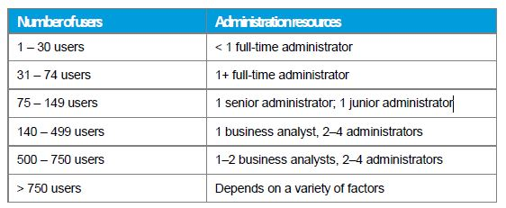
Resourcing for the Future
Getting Assistance
Onsite team to support business processes and reporting
Extended team in IT to provide development support
Premier Support for after hours support
Consultants for project / initiative resourcing
Managed Service contracts during transitions

Slide 10
Centre of Excellence
Defining a Governance Structure
Governance
  Governance is the processes that ensure the effective and efficient use of technology in enabling an organization to achieve its goals.
Business Management
  Empower the business: know what to deliver, why it is important and the value to the business
Change Management
  Process to manage enhancements, timely delivery to market, prioritization and utilization of resources
Release Management
  Ensure highest quality with structured processes and methodology
Support Management
  Subject Matter Expertize, responsiveness and education
Governance
Business Management
Support Management
Release Management
Change Management

Slide 11
Summary
Tying it all Together
Quantify the Amount of Time Spent on Various Groups of Tasks
Qualify the Types of Tasks being Completed to Identify Value Added Items
Create a Plan that includes a Roadmap and Resourcing for the Future
Execute –Build a Business Case

